Slide 1
Web Programming
Lecture 5
JavaScript
Notes:
.

Slide 2
What is javascript?
A lightweight, interpreted programming language.
Used for creating dynamic and interactive web content.
Runs in the browser (client-side) and on servers (Node.js).
Example Uses:
Form validations.
Animations.
Updating DOM dynamically.

Slide 3
Why javascript?
One of the most popular languages in the world.
Essential for web development (HTML + CSS + JS).
Versatile: Can be used for frontend, backend, game development, and more.
Tons of libraries and frameworks (React, Angular, etc.).

Slide 4
Inline JavaScript
<a href="#" onClick="alert('Hey I am Inline JavaScript');">click here</a>

Slide 5
Embedded JavaScript
<html>
<head>
<script>
alert(“Embedded JavaScript");
</script>
</head>
The simple HTML puts a reference to external JavaScript file inside the script tag
Adding src attribute to the script tag causes browsers to look for that file.

Slide 6
Using External Scripts
<html>
<head>
<script src=“script.js”></script>
</head>
The simple HTML puts a reference to external JavaScript file inside the script tag
Adding src attribute to the script tag causes browsers to look for that file.

Slide 7
JavaScript’s Reputation
• Everything is case sensitive, including function, class, and variable.
• When using var for variable declaration,The scope of variables in blocks is not supported. This means variables declared inside a loop may be accessible outside of the loop, counter to what one would expect.
• JavaScript is dynamically typed, meaning a variable can hold values of different data types at different times without explicit type declaration.
• There is a === operator, which tests not only for equality but type equivalence.
• Null and undefined are two distinctly different states for a variable.

Slide 8
JavaScript’s Reputation
• Semicolons are not required, but are permitted (and encouraged).
• There is no integer type or float type, only number type.

Slide 9
Javascript Basic Syntax
Variables: name = "John";
let name = "John";
const pi = 3.14;
var age = 25;
Data Types: String, Number, Boolean, Object, Array, Undefined, null
Operators: +, -, *, /, %, ++, - - , ==, ===, !=, !==, >, <, >=, <=, &&, ||.
Example Code: let sum = 5 + 3;
console.log("Sum is", sum); // Output: Sum is 8

Slide 10
Data Types
// Numbers:
let length = 16;
let weight = 7.5;
// Strings:
let color = "Yellow";
let lastName = "Johnson";
// Booleans
let x = true;
let y = false;
// Object:
const person = {firstName:"John", lastName:"Doe"};
// Array object:
const cars = ["Saab", "Volvo", "BMW"];
// Date object: const date = new Date("2022-03-25");

Slide 11
Difference: var, let and const
var and let create variables that can be reassigned another value.
const creates "constant" variables that cannot be reassigned another value.
developers shouldn't use var anymore. They should use let or const instead.
if you're not going to change the value of a variable, it is good practice to use const.

Slide 12
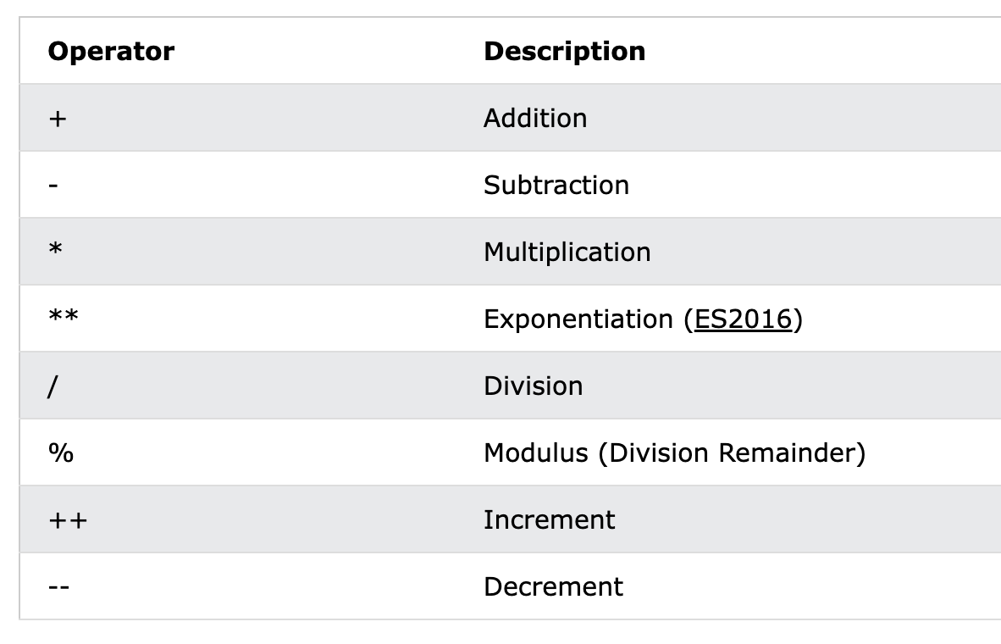
Arithmetic operators
JavaScript performs implicit type coercion
String Coercion (Number → String)
When a number is added to a string, JavaScript converts the number into a string and performs concatenation. console.log(2 + "2"); // "22"
Number Coercion (String → Number)
When a string contains a number and is used with mathematical operators (-, *, /), JavaScript converts it into a number. console.log("10" - 5); // 5

Slide 13
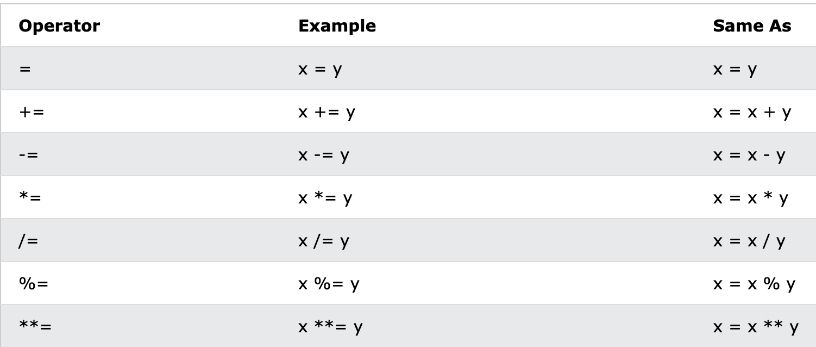
JS Assignment operators

Slide 14
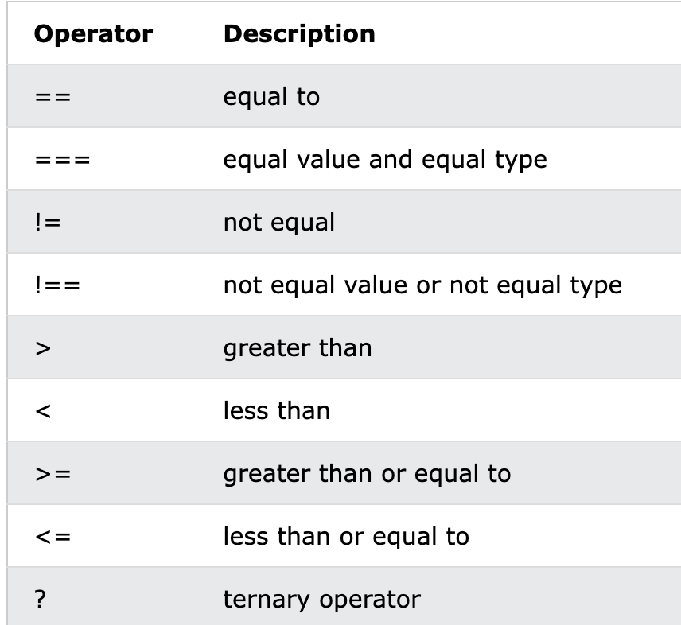
JS Comparison Operators

Slide 15
== VS ===
1==”1” returns true because it converts the string operand to a number and then compares.
1===”1” returns false because the === operator is the strict equality operator, meaning it checks both the value and the type.
In JavaScript, only the === and !== operators perform strict comparison without type coercion. Other operators perform type coercion

Slide 16
JS Objects
An object in JS contains key-value pairs.
An object can be nested, i.e., an object can contain another object.
Keys are strings, and the values can be any data type (numbers, booleans, other objects, functions etc.).

Slide 17
JS Objects
// Create an Object
const person = {
firstName: "John",
lastName: "Doe",
age: 50,
eyeColor: "blue"
};
let firstName = person.firstName
let age = person[“age”]
Add new property: person.nationality = "English";
Delete a property: delete person.age;

Slide 18
JS Nested Objects
myObj = {
name:"John",
age:30,
myCars: {
car1:"Ford",
car2:"BMW"
}
}
myObj.myCars.car2;
myObj.myCars["car2"];
myObj["myCars"]["car2"];

Slide 19
String methods
length
charAt()
toUpperCase()
toLowerCase()
at()
[ ]
slice()
substring()
substr()
explore using links
concat()
trim()
trimStart()
trimEnd()
padStart()
padEnd()
repeat()
replace()
replaceAll()
split()

Slide 20
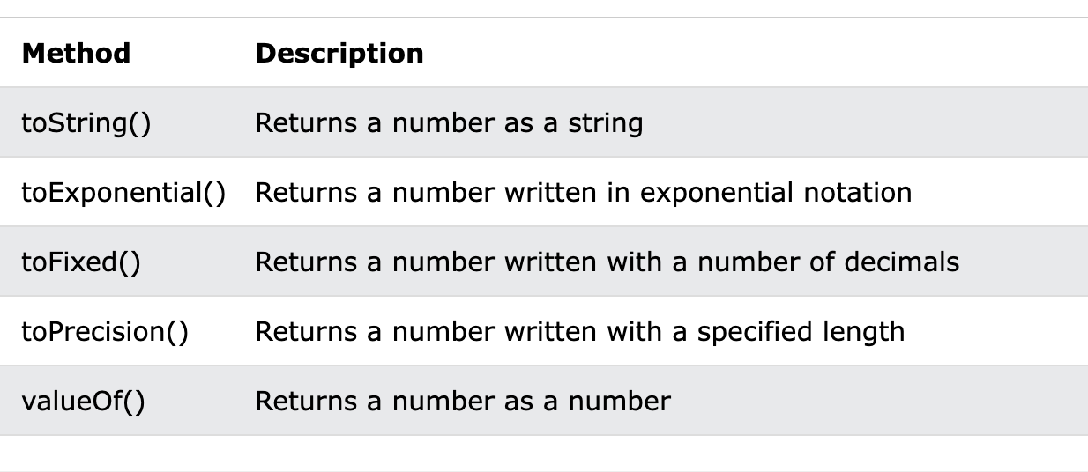
Number methods

Slide 21
Array Methods
sort()
reverse()
map()
filter()
forEach()
const numbers1 = [45, 4, 9, 16, 25];
const numbers2 = numbers1.map(myFunction);
function myFunction(value, index, array) {
return value * 2;
}
length
toString()
at()
join()
pop()
push()
shift()
unshift()
delete()
concat()
explore these using links
and more

Slide 22
JS Dates
const d = new Date();
const d = new Date("2022-03-25");
new Date(year,month,day,hours,minutes,seconds,ms)
Math.random();

Slide 23
Destructuring
The destructuring assignment syntax unpack object properties into variables:
const person = {
firstName: "John",
lastName: "Doe",
age: 50
};
// Destructuring
let {firstName, lastName, country = "US"} = person;

Slide 24
Destructuring
function createPerson({
name = 'Unknown',
age = 0
} = {}) {
return {name, age};
}
console.log(createPerson({name: 'Alice', age:30}));
// { name: 'Alice', age: 30 }
console.log(createPerson({}));
// { name: 'Unknown', age: 0 }
console.log(createPerson());
// { name: 'Unknown', age: 0 }

Slide 25
Function Declaration
function functionName(parameter1, parameter2) {
// Code to be executed
return result;
}
Function with default parameters:
function functionName(parameter1, parameter2=”default value”) {
// Code to be executed
return result;
}

Slide 26
Arrow Function
Arrow functions in JavaScript provide a more concise syntax for writing functions. They are particularly useful for short function bodies.
If the function has a single expression, you can omit the curly braces and the return statement:
const add = (a, b) => a + b;
const functionName = (param1, param2) => {
// function body
return param1 + param2;
};

Slide 27
Arrow Function
If there is only a single parameter, then you can remove parentheses around parameter.
const functionName = param1 => {
// function body
return param1 + 1;
};
const functionName = param1 => param1+1

Slide 28
Resources to Learn
Slide 15: Resources to Learn More
Websites:
MDN Web Docs.
JavaScript.info.
Platforms:
FreeCodeCamp, Codecademy, or W3Schools.

